Slide 1
Week 2: Discrete Random Variables

Slide 2
Experiment: IPL powerplay over
Outcome
What happens with each ball
Was it a legal delivery?
Runs, wickets
Lots of detail
Numerical values of interest
Number of runs in the over
Number of actual deliveries
Number of wickets
Number of boundaries
Number of dot balls
etc….
team | 0.1 | 0.2 | 0.3 | 0.4 | 0.5 | 0.6 | 0.7
KKR | 1 | 0 | 1 | 0 | 0 | 0 | 1
RCB | 1 | 1 | 0 | 1 | 1 | 0 | 0
CSK | 0 | 0 | 1 | 0 | 4 | 0
KXIP | 4 | 0 | 0 | 1 | 0 | 4
Random variables: numerical values computed from the outcomes of the experiment.

Slide 3
Random variables
DEFINITION (Random variable) A random variable is a function with domain as the sample space of an experiment and range as the real numbers, i.e. a function from the sample space to the real line. There is a technical condition that the function needs to satisfy, and we will describe that soon.
Toss a coin, Sample space = { H, T }
Random variable X: X(H) = 0, X(T) = 1
Random variable Y: Y(H) = -10, Y(T) = 200
Random variable Z: Z(H) = √2, Z(T) = π
Random variable U: U(H) = 0, U(T) = 0
While all of the above are valid random variables, usually meaningful functions are considered!

Slide 4
Example: Throw a die
Sample space = { 1, 2, 3, 4, 5, 6 }
A random variable X can be defined as follows
Pick any 6 real numbers x₁, x₂, x₃, x₄, x₅, x₆
X(1) = x₁, X(2) = x₂, X(3) = x₃, X(4) = x₄, X(5) = x₅, X(6) = x₆
What values for x₁, x₂, x₃, x₄, x₅, x₆?
If x_{i}’s are distinct, random variable is a one-to-one function
Essentially, same as sample space
However, x_{i}’s need not be distinct
Random variable E: E(2) = E(4) = E(6) = 1, E(1) = E(3) = E(5) = 0

Slide 5
Random variables and events
If X is a random variable,
(X < x) = {s ∊ S: X(s) < x} is an event for all real x.
So, (X > x), (X = x), (X ≤ x), (X ≥ x) are all events.
Technical condition mentioned earlier
Throw a die, Sample space = { 1, 2, 3, 4, 5, 6 }
X(1) = 1, X(2) = 2, X(3) = 3, X(4) = 4, X(5) = 5, X(6) = 6
X = 1: die shows 1, X < 4: event {1, 2, 3}
Any event can be expressed in terms of X
Event {2, 5}: (X=2) ⋂ (X=5)

Slide 6
Example
Throw a die, Sample space = { 1, 2, 3, 4, 5, 6 }
Random variable E: E(2) = E(4) = E(6) = 1, E(1) = E(3) = E(5) = 0
E = 0: event {1, 3, 5}
E = 1: event {2, 4, 6}
E < 0: null event
E ≤ 1: { 1, 2, 3, 4, 5, 6 }
Note: not all events can be written in terms of E

Slide 7
Why random variables?
IPL powerplay over: Several random variables can be defined
Number of runs in the over
Number of actual deliveries
Number of wickets
Number of boundaries
Number of dot balls
Etc….
Instead of trying to assign probabilities to the entire outcome, we will usually study random variables and assign probabilities to events defined through them.
This reduces the detail in the outcome to something simpler
Using limited data, only such random variables can be studied

Slide 8
Discrete random variables and their distributions

Slide 9
Range of a random variable
DEFINITION (Range of a random variable) The range of a random variable is the set of values taken by it. Range is a subset of the real line.
Given the definition of a random variable, the first task is to find its range.
Examples
Throw a die, X = number shown on die
Range = { 1, 2, 3, 4, 5, 6 } (same as sample space)
Throw a die, E = 0 if number is odd, E = 1 if number is even
Range = { 0, 1 }

Slide 10
Example: IPL powerplay over
Number of actual deliveries
Range: 6, 7, 8, 9, ….
Number of runs in the over
Range: 0, 1, 2, 3, 4, …..
Number of wickets
Range: 0, 1, 2, 3, 4, 5, 6, 7, 8, 9, 10
Number of boundaries
Range: 0, 1, 2, 3, ….
Number of dot balls
Range: 0, 1, 2, 3, 4, 5, 6

Slide 11
Discrete random variable
DEFINITION (Discrete random variable) A random variable is said to be discrete if its range is a discrete set.
What sets are discrete?
All finite subsets of the real line are discrete.
Integers are discrete.
Set of all integer multiples of a real number is discrete.
Any subset of a discrete set is discrete.
What sets are not discrete?
Any interval is not discrete, i.e. (a,b) is not discrete for a < b.
Any subset that contains a non-discrete set is not discrete.

Slide 12
Distribution of a discrete r.v.: Probability Mass Function (PMF)
DEFINITION (PMF) The probability mass function (PMF) of a discrete random variable (r.v.) X with range set T is the function f_{X}: T → [0, 1] defined as
f_{X}(t) = P(X = t) for t ∈ T.
(X = t) is an event. P(X = t) = P(all outcomes that result in X taking value t)
Let B be a subset of T. Consider the event (X ∈ B). P(X ∈ B) = P(all outcomes that result in X taking values in B) = ∑_{t∈B} P(X = t) = ∑_{t∈B} f_{X}(t)

Slide 13
Example: 3 coin tosses
Suppose a fair coin is flipped 3 times.
How many heads will appear?
Which will be the first flip (if any) that shows heads?

Slide 14
Example: 3-digit lottery
For a certain lottery, a three-digit number is randomly selected (from 000 to 999). If a ticket matches the number exactly, it is worth Rs. 2 lakhs. If the ticket matches exactly two of the three digits, it is worth Rs. 20000. Otherwise it is worth nothing. Let X be the value of the ticket. Find the distribution of X.

Slide 15
Random variable, Range and PMF
Random variable X with range T = { t₁, t₂, …., t_{k} }, PMF f_{X}
t | t₁ | t₂ | …. | t_{k}
f_{X}(t) | f_{X}(t₁) | f_{X}(t₂) |  | f_{X}(t_{k})
Properties of PMF
0 ≤ f_{X}(t) ≤ 1 (why? f_{X}(t) = P(X = t) is a probability)
∑_{t∈T} f_{X}(t) = 1 (why? P(X ∈ T) = 1)
Often, random variables and their PMFs are studied without much mention of experiment or sample space
Events are defined using random variables
Probabilities evaluated using PMF

Slide 16
Example: Working with PMF 1
PMF of a random variable X is given partially in the following table.
t | -1 | 1 | 2 | 4
f_{X}(t) | 0.5 | 0.25 | 0.125
Find f_{X}(4). Find the range of X. Find P(X>3). Find P(X<3/2).

Slide 17
Example: Working with PMF 2
The PMF of a random variable X is given below:
f_{X}(k) = c / 3^{k} for k = 1,2,3,...
Find c. Find P(X>10). Find P(X>10 | X > 5).

Slide 18
Common Distributions

Slide 19
Uniform random variable
X ~ Uniform(T), where T is some finite set
Range: Finite set T
PMF: f_{X}(t) = 1/|T| for all t ∈ T
Example:
Toss a fair coin, X ~ Uniform({ 0, 1 }), where 0 - heads, 1 - tails.
Throw a fair die, X ~ Uniform({ 1, 2, 3, 4, 5, 6 })

Slide 20
Bernoulli random variable
X ~ Bernoulli(p), where 0 ≤ p ≤ 1
Range: { 0, 1 }
PMF: f_{X}(0) = 1 - p, f_{X}(1) = p
Example:
Bernoulli trial, p = prob of success, X ~ Bernoulli(p)

Slide 21
Binomial random variable
X ~ Binomial(n, p), where n: positive integer, 0 ≤ p ≤ 1
Range: { 0, 1, 2, …., n }
PMF: f_{X}(k) = nC_{k} p^{k} (1-p)^{n-k}
Example:
Number of successes in n independent Bernoulli(p) trials
Check that the above PMF is valid
nC_{k} p^{k} (1-p)^{n-k} ≥ 0
∑_{k} nC_{k} p^{k} (1-p)^{n-k} = 1

Slide 22
Geometric random variable
X ~ Geometric(p), where 0 < p ≤ 1
Range: { 1, 2, 3, …. }
PMF: f_{X}(k) = (1-p)^{k-1} p
Example:
Number of trials for first success in repeated independent Bernoulli(p) trials
Check that the above PMF is valid
Sum of a geometric progression formula
Start at 0: Some use range as { 0, 1, 2, 3, …. } and f_{X}(k) = (1-p)^{k}p

Slide 23
Negative Binomial random variable
X ~ Negative Binomial(r, p), where r: positive integer, 0 < p ≤ 1
Range: { r, r+1, r+2, …. }
PMF: f_{X}(k) = (k-1)C_{r-1} (1-p)^{k-r} p^{r}
Example:
Number of trials for r success in repeated independent Bernoulli(p) trials
r = 1: geometric random variable
Check that the above PMF is valid
A bit more complicated…..

Slide 24
Poisson random variable
X ~ Poisson(λ), where λ > 0
Range: { 0, 1, 2, 3, …. }
PMF: f_{X}(k) = e^{-λ} λ^{k} / k!
k | 0 | 1 | 2 | 3 | 4 | ….
f_{X}(k) | e^{-λ} | e^{-λ}λ | e^{-λ}λ²/2! | e^{-λ}λ³/3! | e^{-λ}λ⁴/4!
Check PMF is valid: use expansion for e^{λ} = 1 + λ + λ²/2! + λ³/3! + λ⁴/4! + ….

Slide 25
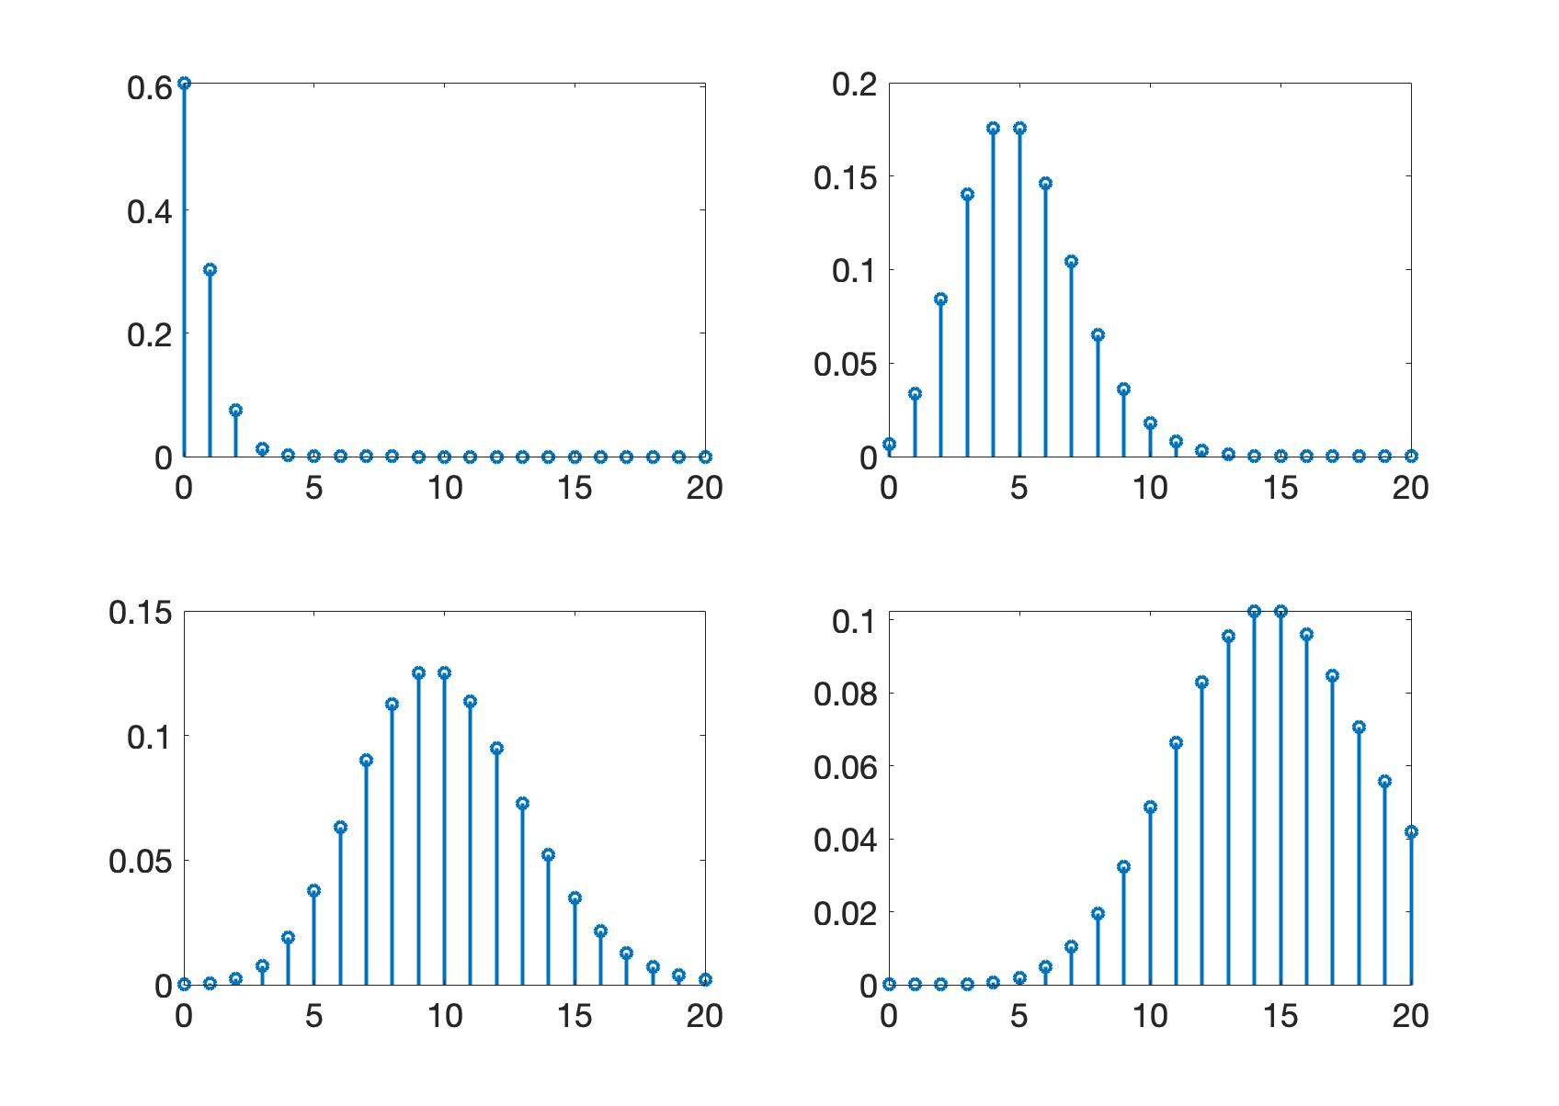
Sketch of Poisson PMF
λ = 0.5
λ = 5
λ = 10
λ = 15

Slide 26
Hypergeometric random variable
X ~ HyperGeo(N, r, m), where N, r, m: positive integers
Consider a population of ‘N’ persons with ‘r’ of Type 1 and ‘N - r’ of Type 2
Select ‘m’ persons uniformly at random without replacement
X = number of persons of Type 1 selected
Range of X
N = 100, r = 50, m = 20 => X ∈ 0, 1, 2, …, 20
N = 100, r = 10, m = 20 => X ∈ 0, 1, 2, …, 10
N = 100, r = 90, m = 20 => X ∈ 10, 11, 12, …, 20
X ∈ max(0, m - (N-r)), …, min(r, m)

Slide 27
PMF of Hypergeometric random variable
X ~ HyperGeo(N, r, m), where N, r, m: positive integers
Range: {max(0, m - (N-r)), …, min(r, m)}
PMF: f_{X}(k) = rC_{k} (N-r)C_{m-k} / NC_{m}
Arises in sampling for trials

